Slide 1

Data-driven identification of a one-link robot with flexible joint
Master in Artificial Intelligence and Robotics
Lagrangian Neural Networks applied to elastic robots
Course: Robotics 2
Professor: Alessandro De Luca
Tutor: Pietro Pustina
Students: Lorenzo Cirillo 1895955, Claudio Schiavella 1884561

Slide 2


INTRODUCTION
Robot dynamic model
Relationship between applied forces and motion
D’Alembert, Hamilton
Euler-Lagrange equations
Modeling and control
Symbolic form equations of motions
Modeling systems Neural networks Lagrangian NN
Notes:
focus su una traiettoria (grafici + rmse)

Slide 3
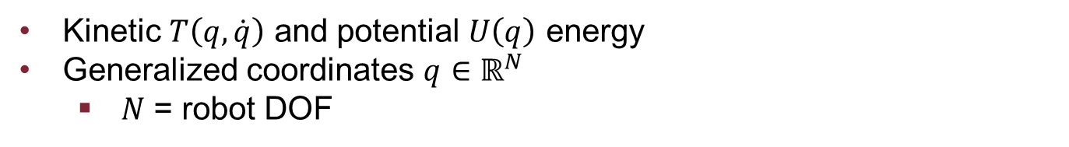
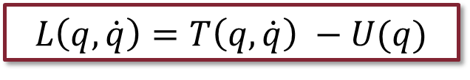


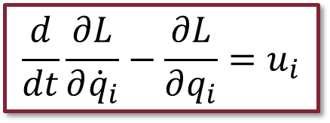
PARAMETRIC LAGRANGIAN
Lagrangian
$$L\left(q,\dot{q}\right)=T\left(q,\dot{q}\right) −U(q)$$
Kinetic $T\left(q,\dot{q}\right)$ and potential $U\left(q\right)$ energy
Generalized coordinates $q∈ℝ^{N}$
$N$ = robot DOF
Euler-Lagrange equations
$$\frac{d}{dt}\frac{∂L}{∂{\dot{q}}_{i}}−\frac{∂L}{∂q_{i}}=u_{i}$$
$$i=1,…, N$$
Non-conservative forces $u_{i}$
Considered null in our application

Slide 4
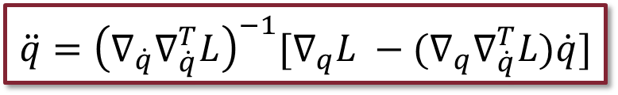
PARAMETRIC LAGRANGIAN
Parametric Lagrangian
$$\ddot{q}={\left(∇_{\dot{q}}∇_{\dot{q}}^{T}L\right)}^{−1}[∇_{q}L −(∇_{q}∇_{\dot{q}}^{T}L)\dot{q}]$$
Lagrangian analytical expression not always known
Alternative approach
Learning L + Automatic differentiation
Notes:
Espandere, alternative approach è apprendere la lagrangiana e la imparo -> non nota L, la imparo (cosi so stutto sul Sistema), come la imparo? Non la posso misurare, allora sfrutto il fatto che posso misurare l’accelerazione oppire posizione evelocità e quindi sfruttando l’automatic differentiation data una L qualsisasi get the q dot dot, che poi integro

Slide 5
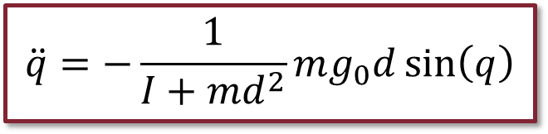
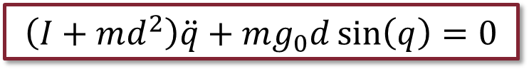
RIGID ROBOT
1R robot with y-axis agreeing with gravity
Dynamic Model:
$$\left(I+md^{2}\right)\ddot{q}+mg_{0}d\sin\left(q\right)=0$$
Acceleration:
$$\ddot{q}=−\frac{1}{I+md^{2}}mg_{0}d\sin\left(q\right)$$
Coriolis and Centrifugal term not present
One single link
Contribute to the joint when it is moving is null

Slide 6
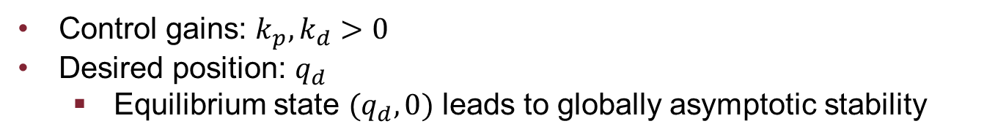
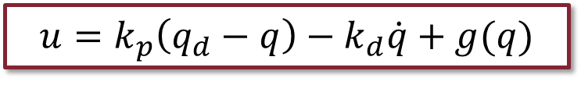
RIGID ROBOT
PD controller with gravity cancellation
Controller:
$$u=k_{p}\left(q_{d}−q\right)−k_{d}\dot{q}+g(q)$$
Control gains: $k_{p},k_{d}>0$
Desired position: $q_{d}$
Equilibrium state $(q_{d},0)$ leads to globally asymptotic stability

Slide 7
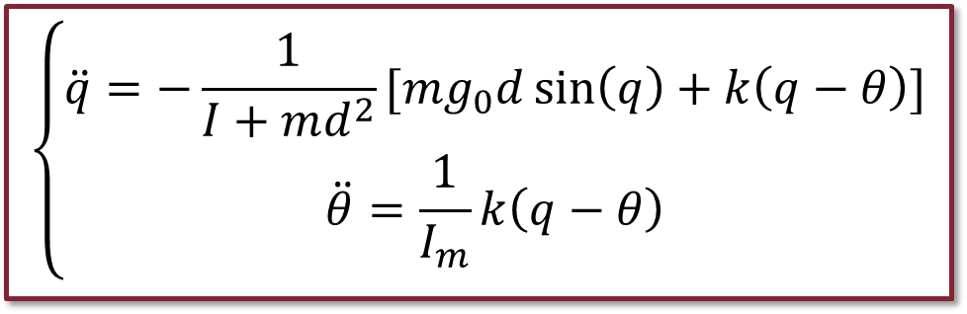
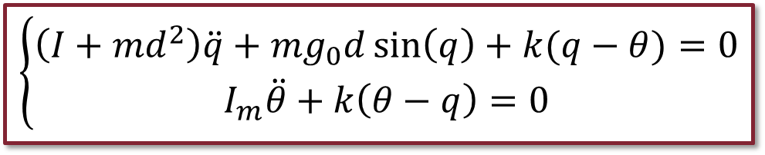
ELASTIC ROBOT
1R robot with y-axis agreeing with gravity
Dynamic model:
$$\left\{\begin{aligned}\left(I+md^{2}\right)\ddot{q}+mg_{0}d\sin\left(q\right)+k(q−θ)=0 \\ I_{m}\ddot{θ}+k\left(θ−q\right)=0\end{aligned}\right.$$
Accelerations:
$$\left\{\begin{aligned}\ddot{q}=−\frac{1}{I+md^{2}}[mg_{0}d\sin\left(q\right)+k\left(q−θ\right)] \\ \ddot{θ}=\frac{1}{I_{m}}k\left(q−θ\right)\end{aligned}\right.$$
Again Coriolis and Centrifugal term not present
Constant inertia matrix

Slide 8
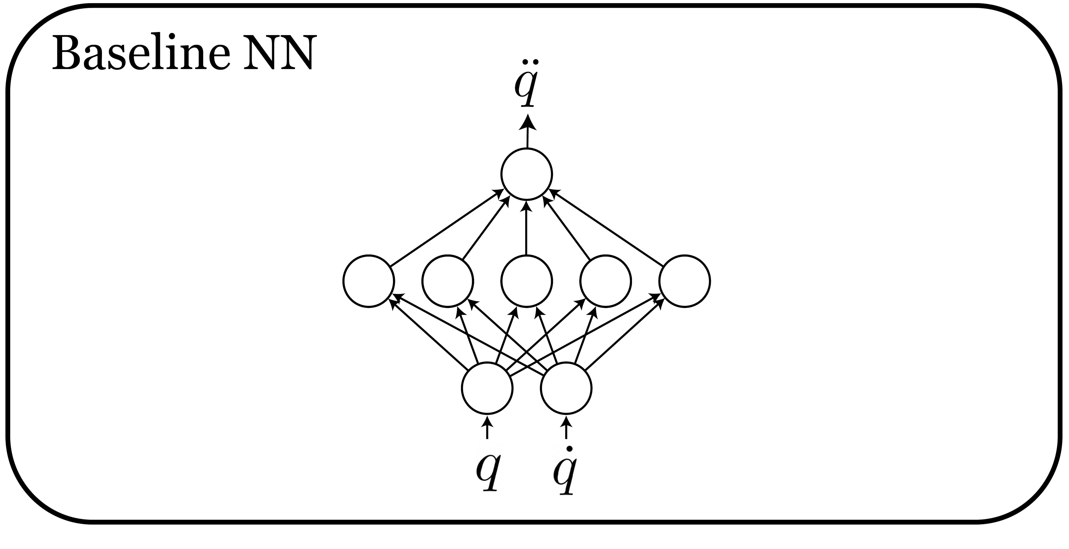
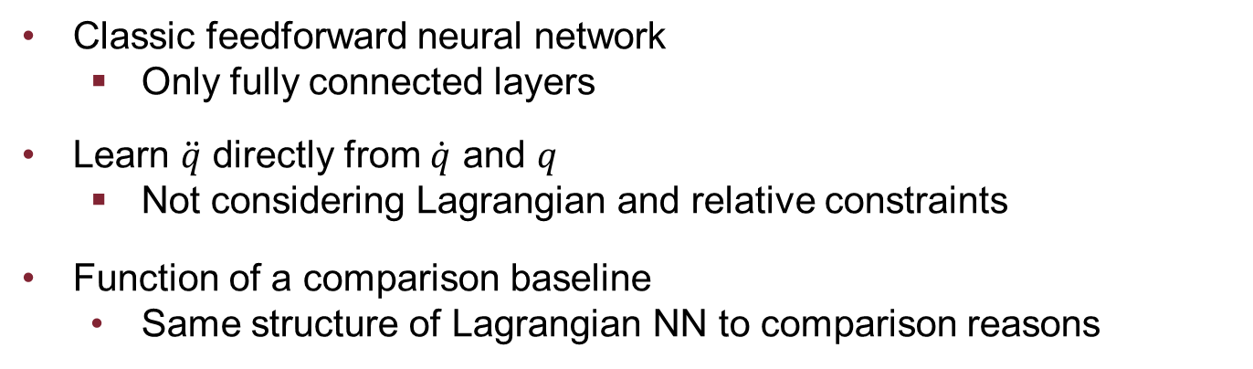
BASELINE NN
Classic feedforward neural network
Only fully connected layers
Learn $\ddot{q}$ directly from $\dot{q}$ and $q$
Not considering Lagrangian and relative constraints
Function of a comparison baseline
Same structure of Lagrangian NN to comparison reasons

Slide 9
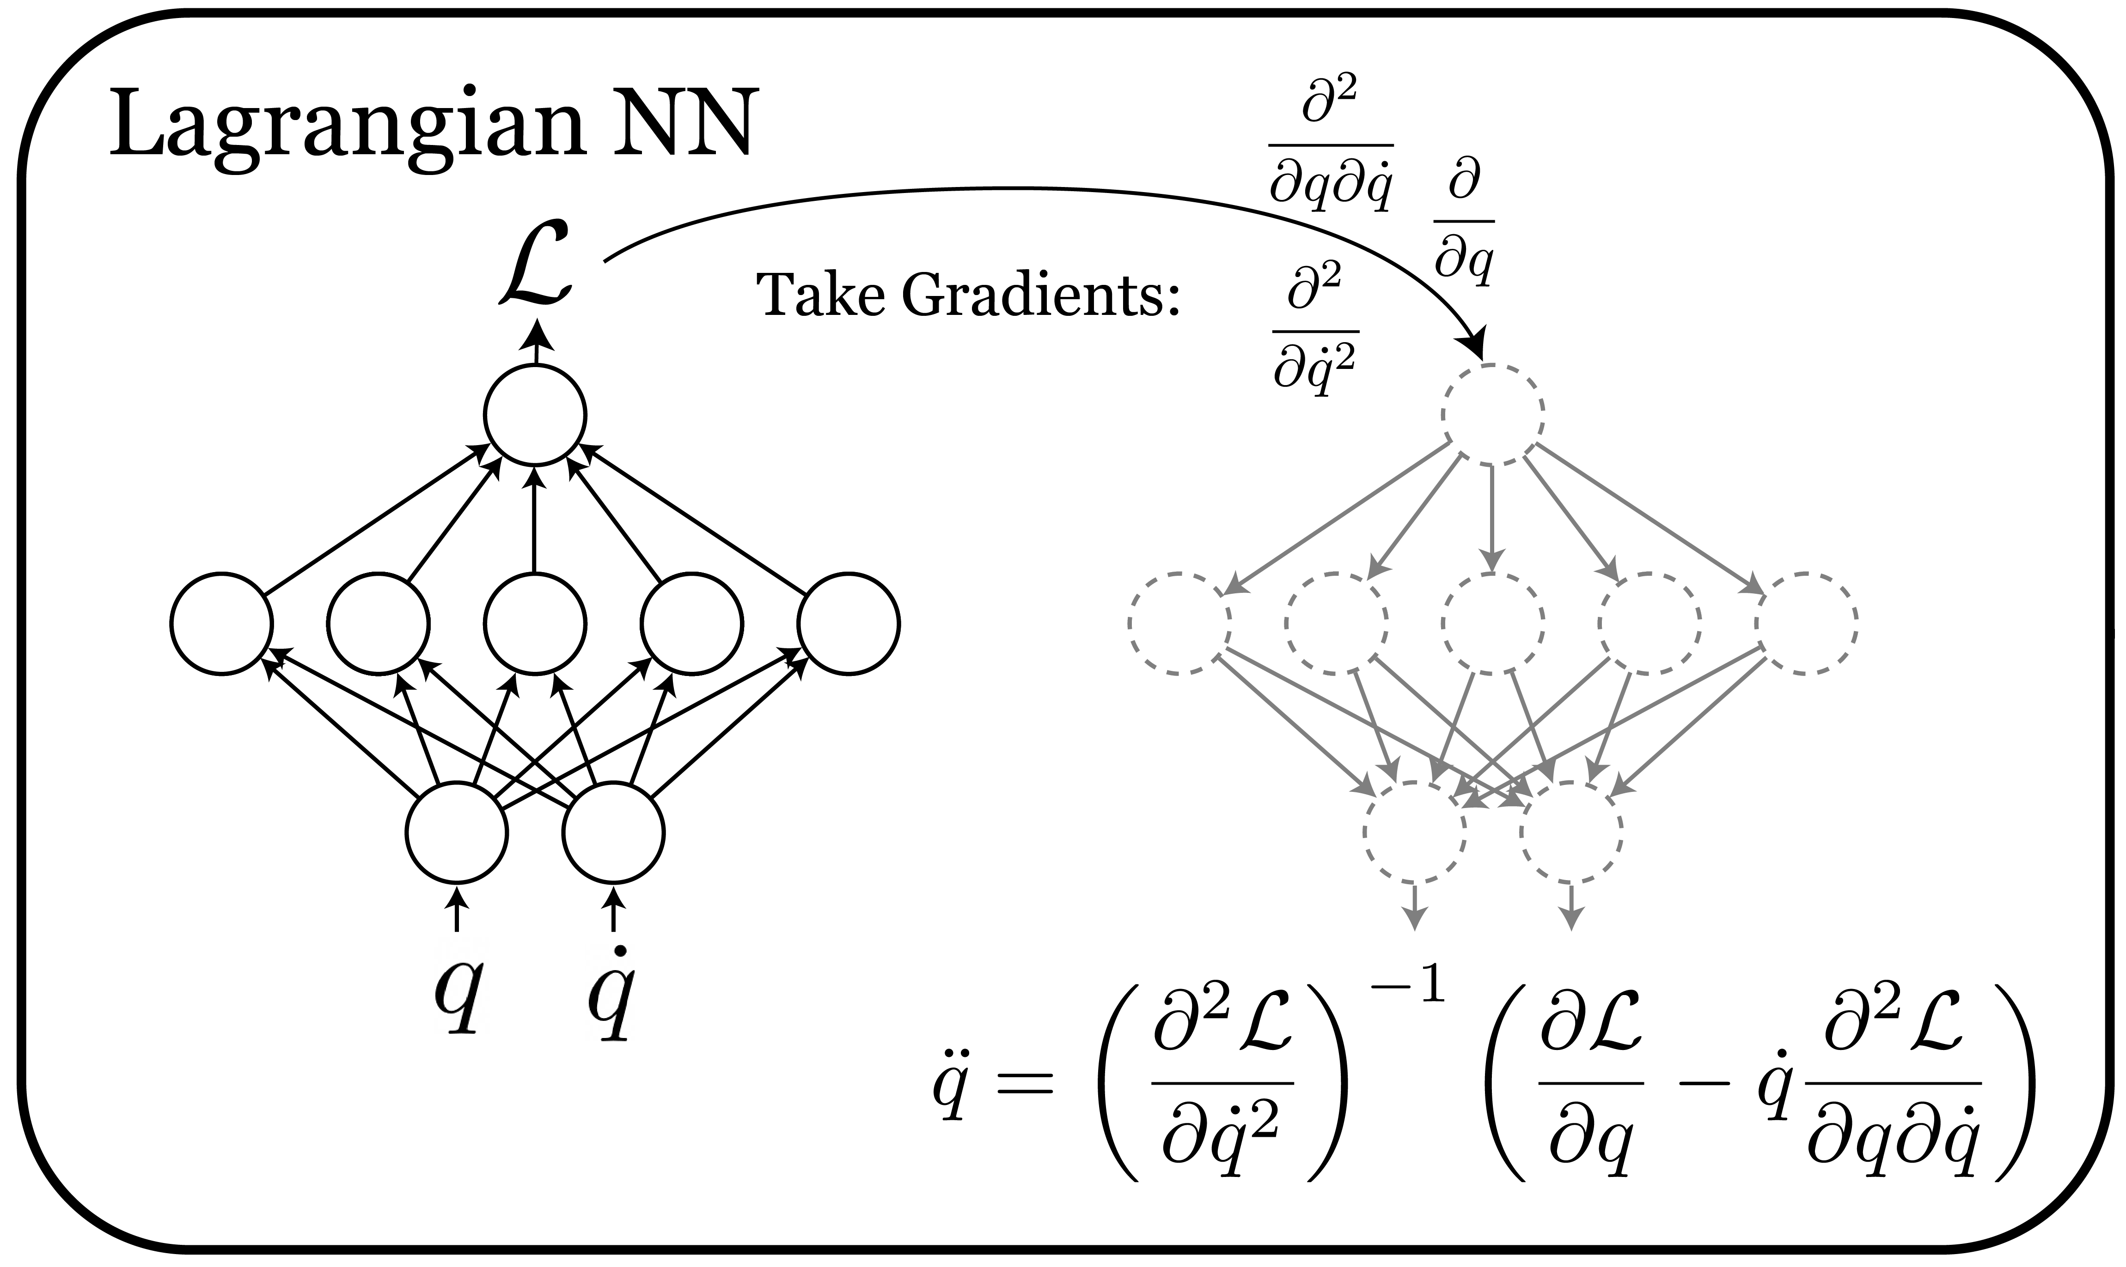
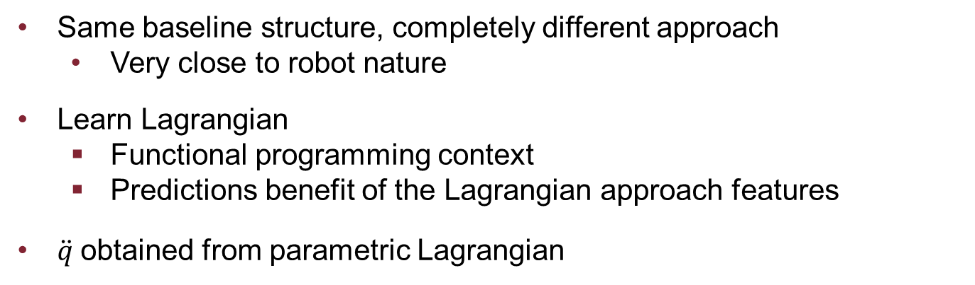
LAGRANGIAN NN
Same baseline structure, completely different approach
Very close to robot nature
Learn Lagrangian
Functional programming context
Predictions benefit of the Lagrangian approach features
$\ddot{q}$obtained from parametric Lagrangian

Slide 10
SIMULATIONS
Type 1: Observe behavior of the two networks
Trajectory tracking
Trajectory error
Energy conservation
Type 2: Introduce measurament noise
Same tests as in type 1
Highlight network robustness in not ideal context
Type 1: Observe behavior of the two networks
Trajectory tracking
Trajectory error
Energy conservation
Type 2: Introduce measurament noise
Same tests as in type 1
Highlight network robustness in not ideal context

Slide 11
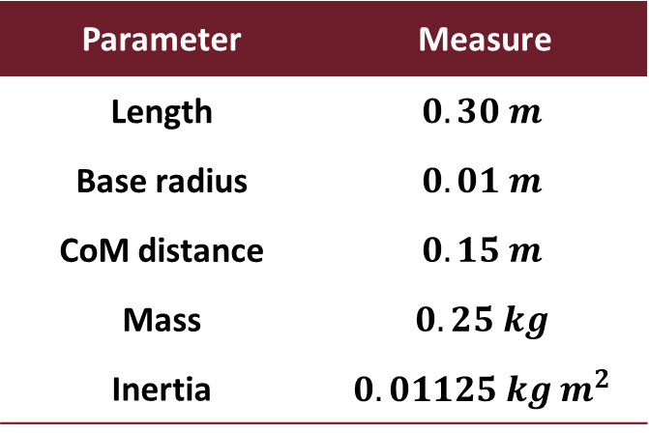
RIGID CASE
Robot parameters
Network setup
Parameter | Measure
Length | $$0.30 m$$
Base radius | $$0.01 m$$
CoM distance | $$0.15 m$$
Mass | $$0.25 kg$$
Inertia | $$0.01125 kg m^{2}$$
Characteristic | Value
Layers | 4
Neurons | 500
Activation | Softplus
Loss | MSE
Regularization | L2 penalty
Train epochs | 10 000

Slide 12
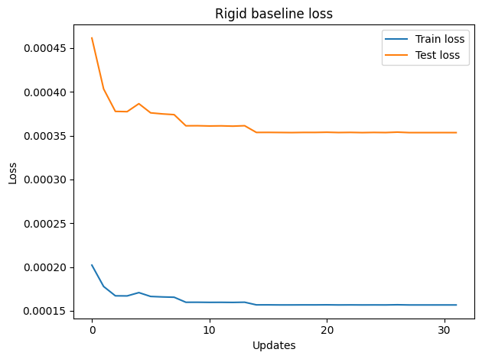
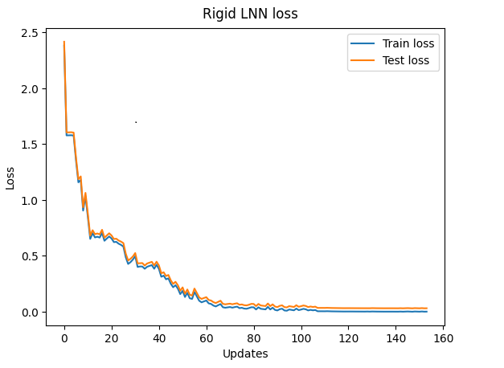
RIGID CASE – NETWORK TRAINING
Train and test losses

Slide 13
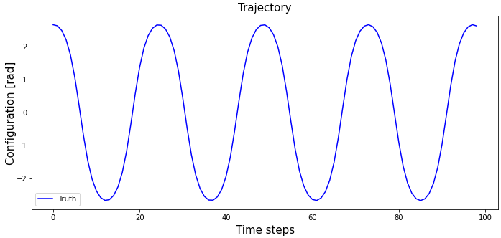
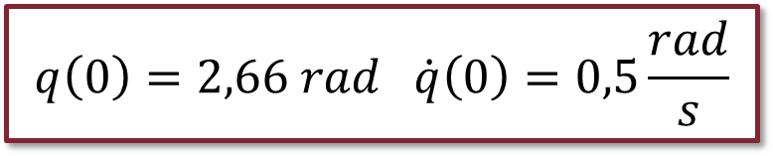
RIGID CASE – SIMULATION
$$q\left(0\right)=2,66 rad \dot{q}\left(0\right)=0,5\frac{rad}{s}$$
Initial conditions:

Slide 14
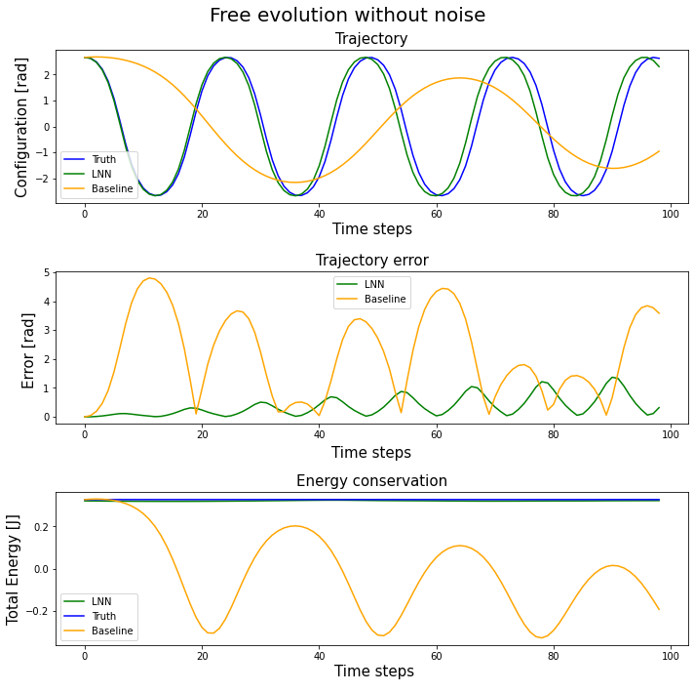
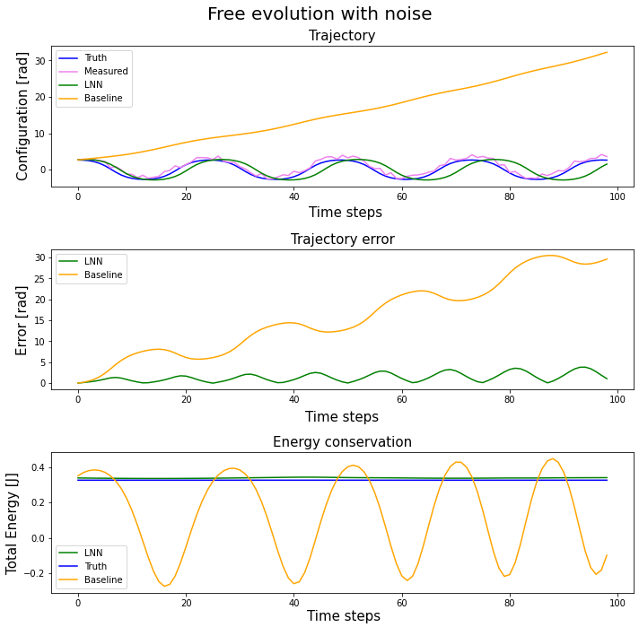
RIGID CASE – SIMULATION
Notes:
Perchè arriva il delay della traiettoria? Le algrangiane non sono identiche, se c’è un errore che si accumula amen (tuttvaia energia simile, tuttavia simu okay, div integrazione accumula errore per def, tuttavia energia è conservata e molto vicina, applicando controllore model based dovrenne funz bene) + simulazione Sistema meccanico a tanti secondi (10 min), quasi sempre diverge la simulazione

Slide 15
RIGID CASE – SIMULATION
RMSE
Networks | No Noise | Noise
Baseline NN | 2.5636 rad | 18.1152 rad
LNN | 0.5096 rad | 1.7531 rad

Slide 16
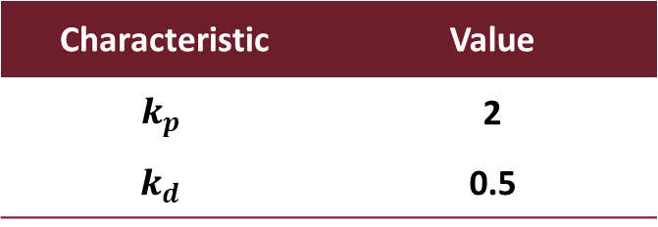
RIGID CASE – CONTROL
Controller setup
Characteristic | Value
$$k_{p}$$ | 2
$$k_{d}$$ | 0.5
Gain values obtained from
Necessary condition for global asymptotic stability
Fine tuning

Slide 17
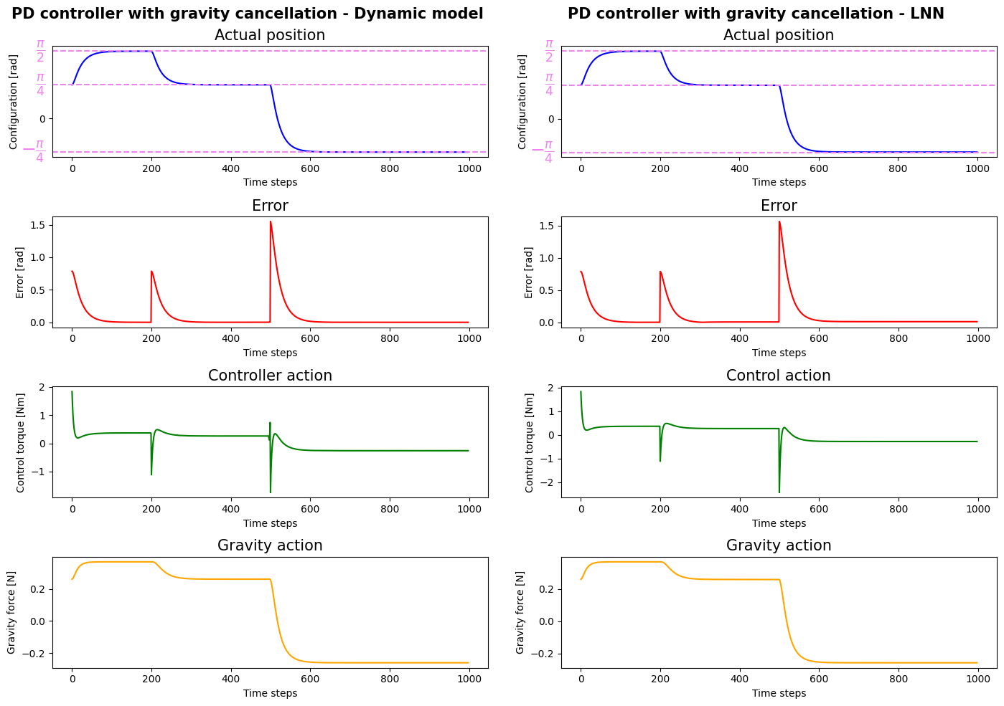
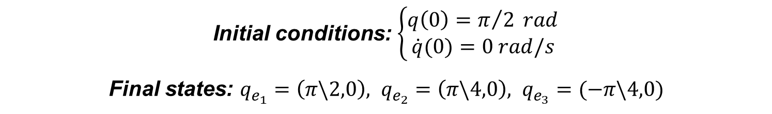
RIGID CASE – CONTROL
Initial conditions: $\left\{\begin{aligned}q\left(0\right)=π/2 rad \\ \dot{q}(0)=0 rad/s\end{aligned}\right.$
Final states: $q_{e_{1}}=\left(π\backslash 2,0\right), q_{e_{2}}=\left(π\backslash 4,0\right), q_{e_{3}}=(−π\backslash 4,0)$

Slide 18

RIGID CASE – CONTROL
Initial conditions: $\left\{\begin{aligned}q\left(0\right)=π/2 rad \\ \dot{q}(0)=0 rad/s\end{aligned}\right.$
Final states: $q_{e_{1}}=\left(π\backslash 2,0\right), q_{e_{2}}=\left(π\backslash 4,0\right), q_{e_{3}}=(−π\backslash 4,0)$

Slide 19
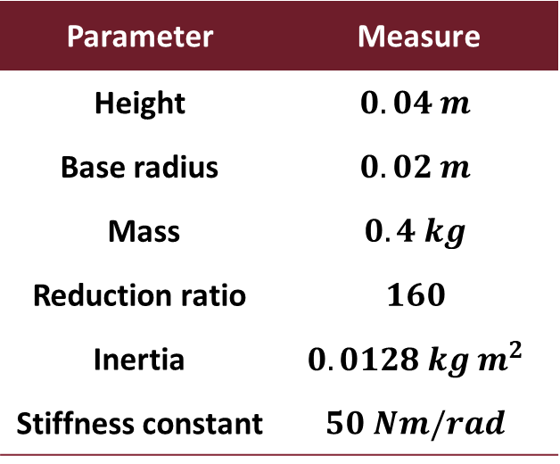
ELASTIC CASE
Motor parameters
Network setup
Parameter | Measure
Height | $$0.04 m$$
Base radius | $$0.02 m$$
Mass | $$0.4 kg$$
Reduction ratio | $$160$$
Inertia | $$0.0128 kg m^{2}$$
Stiffness constant | $$50 Nm/rad$$
Configuration | Units | Layers
A | 300 | 2
B | 500 | 4
C | 700 | 5

Slide 20
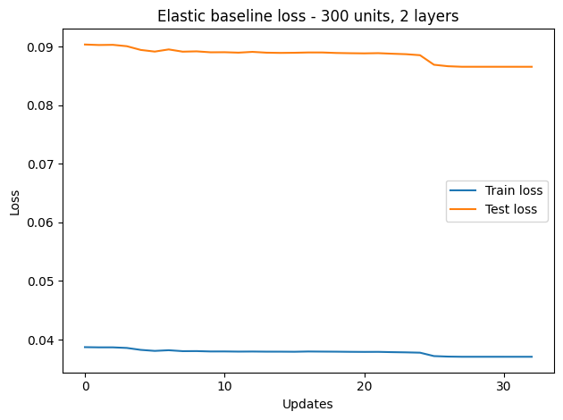
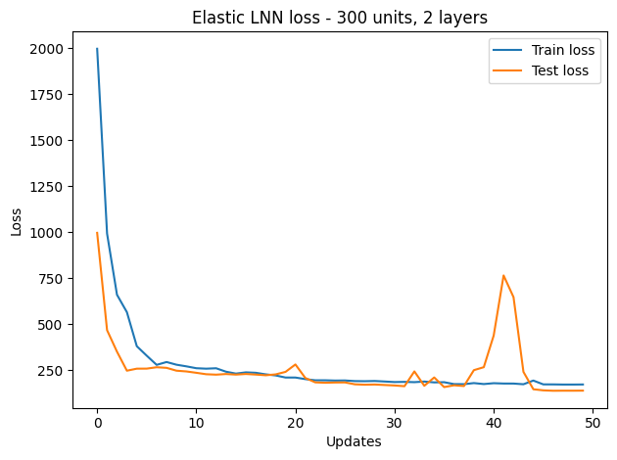
ELASTIC CASE – CONFIGURATION A
Train and test losses
Configuration A: 300 units, 2 layers
Notes:
SPECIFICARE PERCHE DIVERSE SCALE DI UPDATES (perchè impara di più)

Slide 21
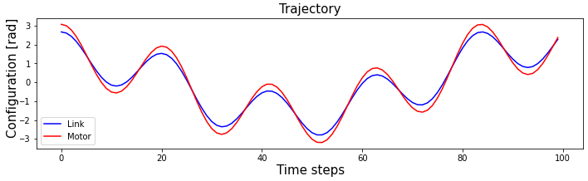
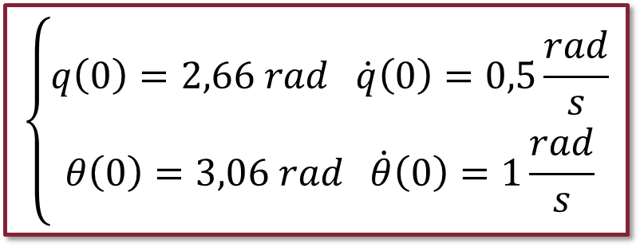
ELASTIC CASE – SIMULATION 1
$$\left\{\begin{aligned}q\left(0\right)=2,66 rad \dot{q}\left(0\right)=0,5\frac{rad}{s} \\ θ\left(0\right)=3,06 rad \dot{θ}\left(0\right)=1\frac{rad}{s}\end{aligned}\right.$$
Initial conditions:

Slide 22
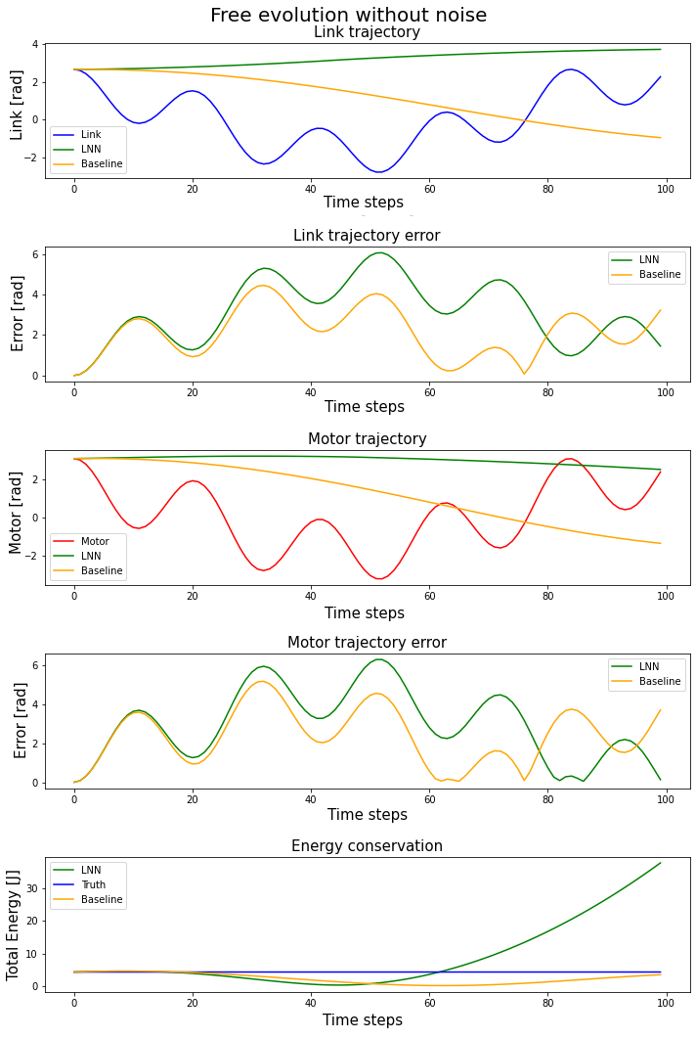
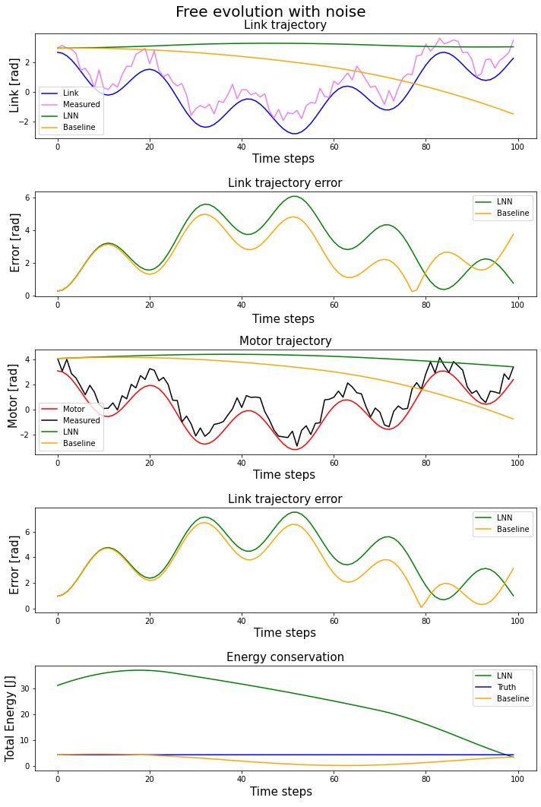
ELASTIC CASE – SIMULATION 1

Slide 23
ELASTIC CASE – SIMULATION 1
RMSE - Link
Networks | No Noise | Noise
Baseline NN | 2.4337 rad | 2.8176 rad
LNN | 3.5242 rad | 3.4831 rad
RMSE - Motor
Networks | No Noise | Noise
Baseline NN | 2.7626 rad | 3.8201 rad
LNN | 3.4796 rad | 4.4901 rad

Slide 24
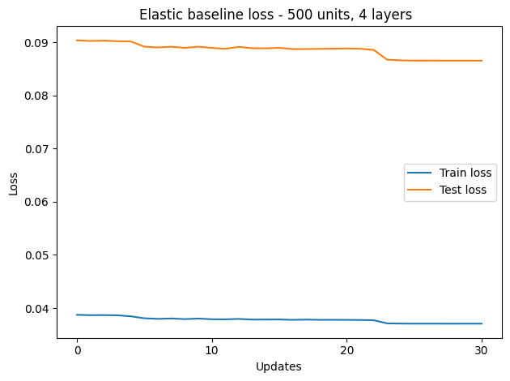
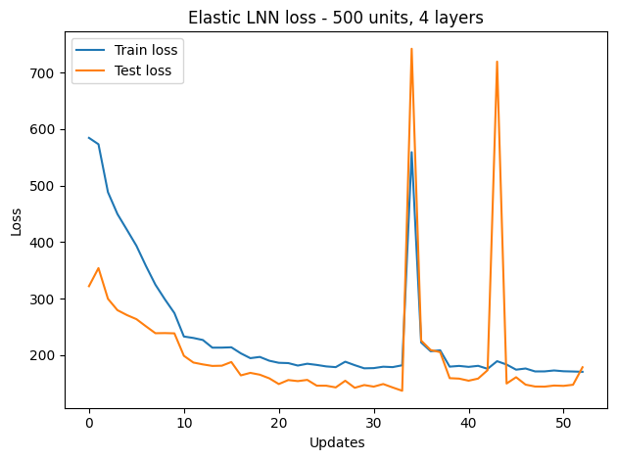
ELASTIC CASE – CONFIGURATION B
Train and test losses
Configuration B: 500 units, 4 layers
Notes:
L’info interessante non è il valore basso di loss, ma che non cala

Slide 25
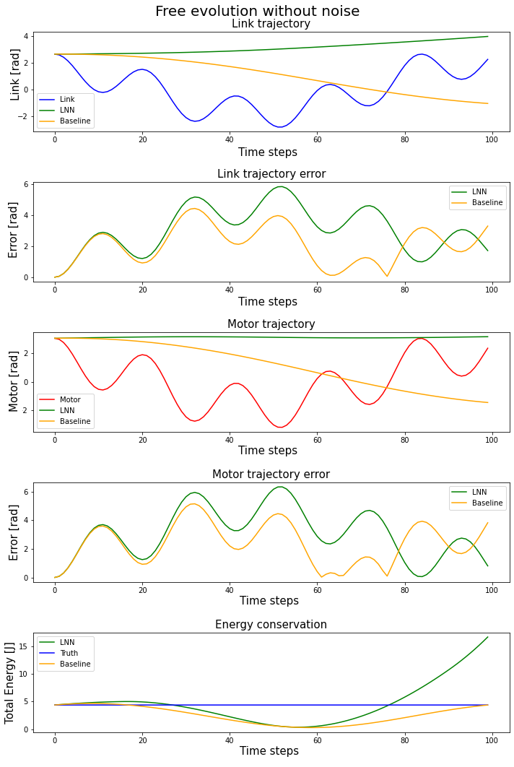
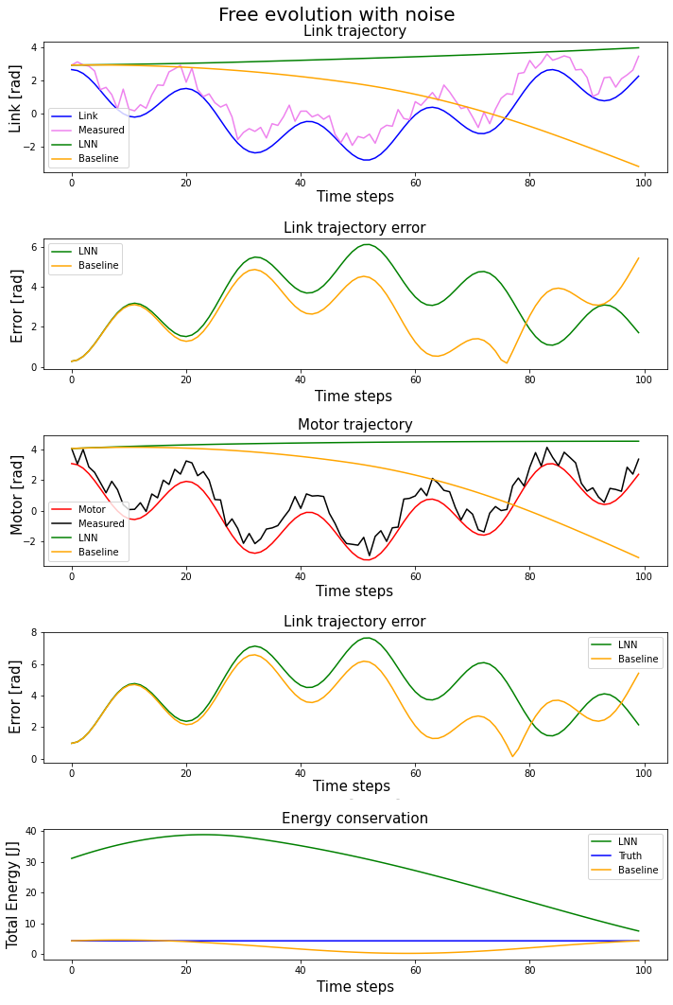
ELASTIC CASE – SIMULATION 2

Slide 26
ELASTIC CASE – SIMULATION 2
RMSE - Link
Networks | No Noise | Noise
Baseline NN | 2.4253 rad | 2.9910 rad
LNN | 3.4193 rad | 3.6460 rad
RMSE - Motor
Networks | No Noise | Noise
Baseline NN | 2.7547 rad | 3.8176 rad
LNN | 3.4556 rad | 4.3988 rad

Slide 27
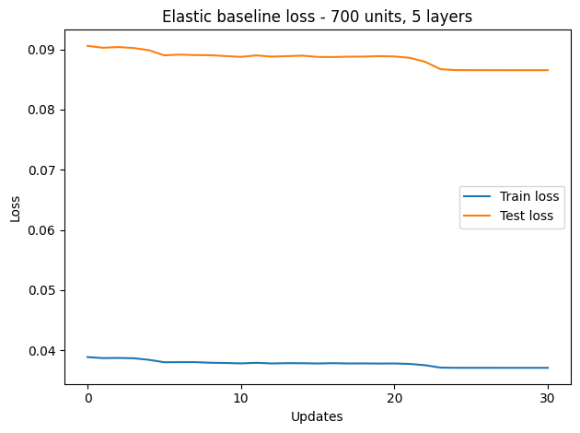
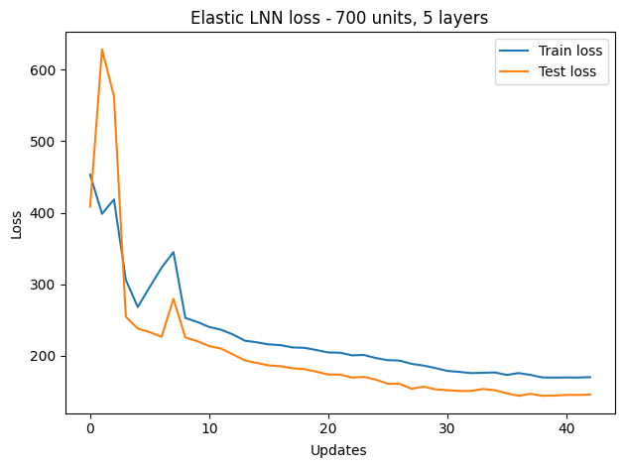
ELASTIC CASE – CONFIGURATION C
Train and test losses
Configuration C: 700 units, 5 layers

Slide 28
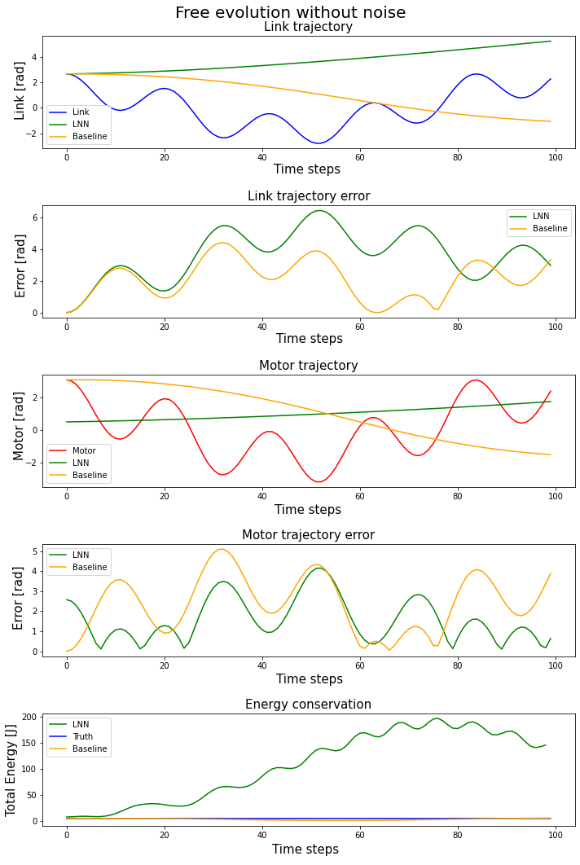
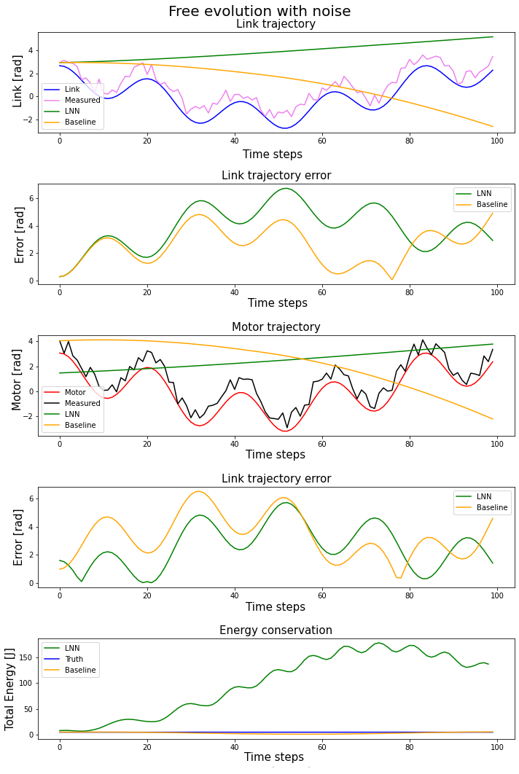
ELASTIC CASE – SIMULATION 3

Slide 29
ELASTIC CASE – SIMULATION 3
RMSE - Link
Networks | No Noise | Noise
Baseline NN | 2.4173 rad | 2.8553 rad
LNN | 3.0199 rad | 3.1879 rad
RMSE - Motor
Networks | No Noise | Noise
Baseline NN | 2.7524 rad | 3.6792 rad
LNN | 1.9237 rad | 3.0289 rad

Slide 30
CONCLUSIONS
At least in the rigid case, LNN performances are very good
Both in trajectory error and energy conservation
Unfortunately, bad results in elastic case
Elastic LNN seems to improve as network complexity increase
More wide/deep network and more initial conditions
High computational resources needed
Paper LNN approach works on unitary configurations
We reject this in preference to real robot parameters

Slide 31
THANK YOU FOR THE ATTENTION

